Slide 1

Coronavirus Goes Viral: Quantifying the COVID-19 Misinformation Epidemic on Twitter
Nikhil Joshi, Vishaal Thanawala, Narasimha Kamath Ardi
MSCA 31012 DEPA SPRING 2020

Slide 2

Agenda
Background
1
4
Data Pipeline
Use Cases
2
5
Text Classification
Data Sources and Tools
Conclusions and Future Scope
3
6

Slide 3
Background
The Issue:
Twitter is a social media platform that allows users to share and receive short posts called tweets. Though it is often used for quickly spreading news and other updates, in more recent times it has been accused of being plagued by misinformation and bots
With the outbreak of the novel coronavirus Covid-19, Twitter has become an echo chamber of hoaxes and rumors on the virus, perpetuating more Covid-19 cases and deaths
Our Plan:
The Twitter API provides data scientists with a goldmine of unstructured data that can be analyzed using techniques from class to identify and classify various types of misinformation
We have targeted 3 major categories of misinformation: 1. Myths, 2. Disinfectants, & 3. Antivirals
Our project utilizes Exploratory Data Analysis, Data Engineering, NLP (Natural Language Processing), & ML (Machine Learning) to classify tweets and even predict whether a tweet has misleading information
In this regard, our project is a baby step towards eradicating harmful data on Twitter

Slide 4
Use Cases
Plot the top 20 most popular hashtags with the number of tweets in each categories.
Display the geographic locations of the collected tweets using Tableau.
Analyze and predict 20 most mentioned tweet accounts.
Search for the top 20 usernames tweeting on a regular basis.
Predict the probability of these usernames being bots.
Plot the histogram for the distribution of polarities for 3 misinformation categories.
Find the tweets, usernames, & tweet ID's with extreme polarities and correlate them with the most mentioned usernames.
Identify the root cause/sources of misinformation.
Apply Naïve Bayes Classifier & Logistic regression to predict the degree of misinformation in the test dataset.

Slide 5
Data Profile
# of tweets: ~76,000
Date range of tweets: 5/22-5/28
# of hashtags to be investigated: 20
# of handles to be investigated: 20
Matching rules: Tweet ID, Hashtag, and Handle
# of Matches
~75,000 for hashtags
~50,000 for handles

Slide 6








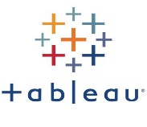



Data Sources & Tools
Sources
|---------------------|
Ingestion & Cleaning
|----------------------------|
Storage
|-------------|
Visualization
|-------------------|
NLP & ML
|--------------------|

Slide 7

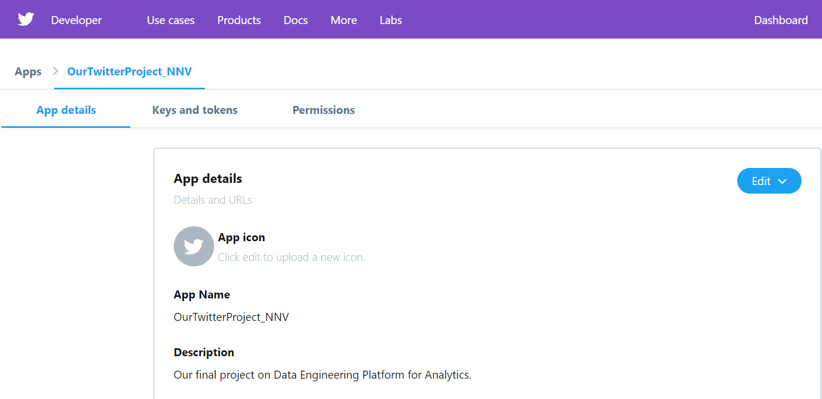
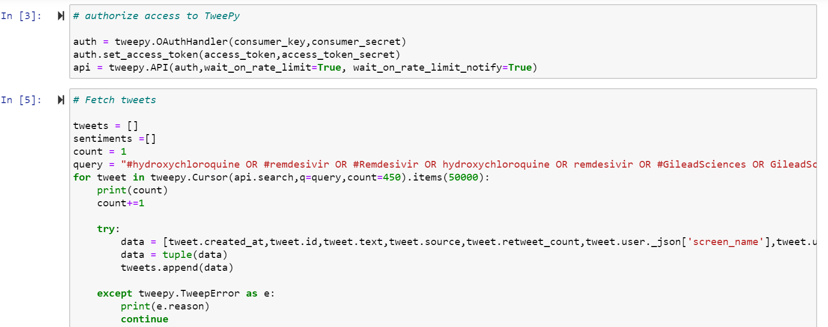
Data Pipeline
Sources:
Twitter
We are using Twitter Developer account as a data source to extract tweets, through TweePy (An in-built python API)
We are connecting to the REST API for tweet search using access keys and tokens.

Slide 8
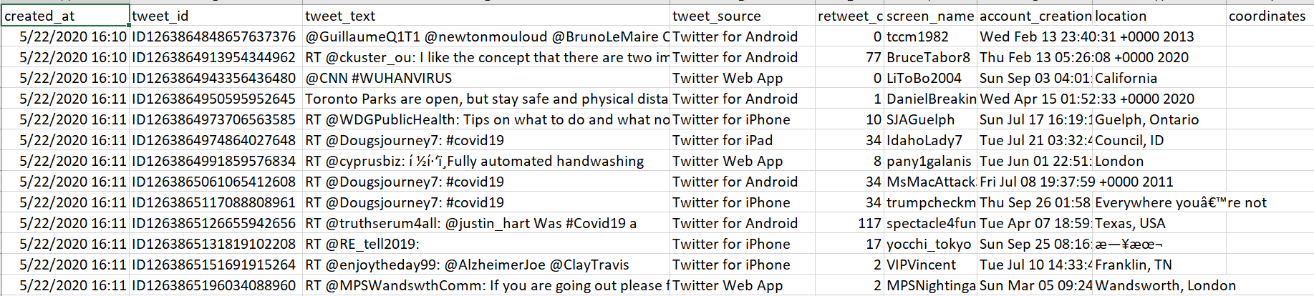
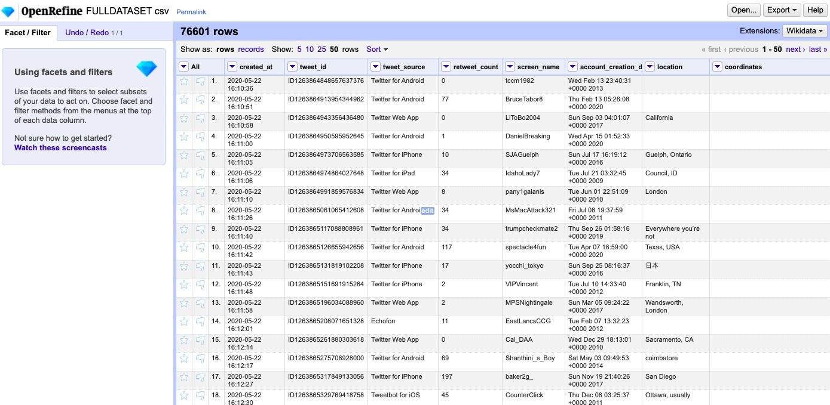
Data Pipeline
Ingestion and Cleaning:
Being an unstructured data, working with twitter dataset can be extremely difficult.
We are connecting to the REST API for tweet search using access keys and tokens and cleaning the unwanted URLs, punctuations in python. Moreover removing the duplicate data with the help of Open refine.

Slide 9
Data Pipeline
Storage:
Being an unstructured data, working with twitter dataset can be extremely difficult.
We are connecting to the REST API for tweet search using access keys and tokens and cleaning the unwanted URLs, punctuations in python. Moreover removing the duplicate data with the help of Open refine.

Slide 10
Data Pipeline
EER Diagram

Slide 11
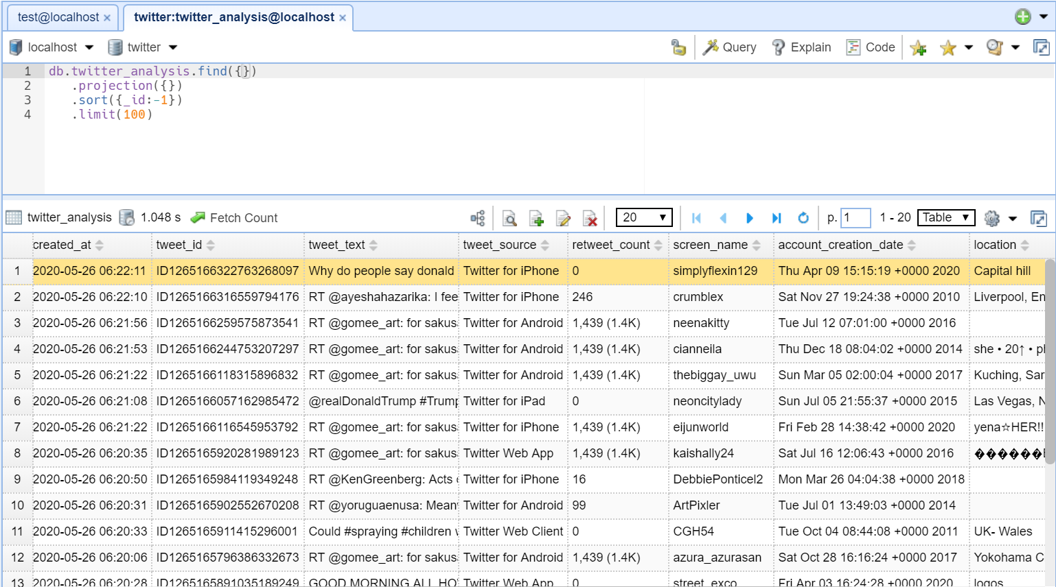
Data Pipeline
MongoDB :
Schema less : MongoDB is a document database in which one collection holds different documents. Number of fields, content and size of the document can differ from one document to another.
No Complex joins & uses internal memory for storing the (windowed) working set, enabling faster access of data.
Our data basically deals with text and can have multiple special characters and emoticons. Loading it to MySQL can be extremely tedious as we faced a lot of data import fails due to twitter text attribute. Thus, MongoDB would be the ideal database in terms of data load and query operations, for our use cases.

Slide 12
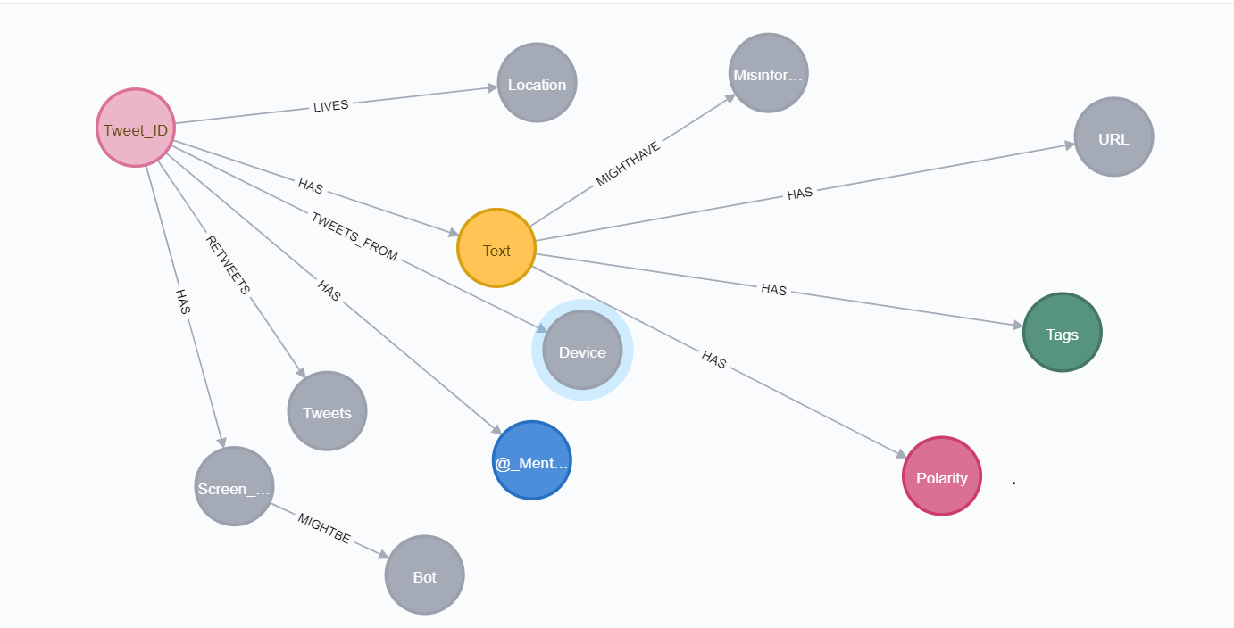
Data Pipeline
Neo4j :
Social media networks are already graphs, so there’s no point converting a graph into tables and then back again. Having a data model that directly matches your domain model helps in better understanding of the data, communicate more effectively and avoid needless work.
Using Neo4j improves the quality and speed of development for the social network application by reducing the time spent on data modeling.
Thus, Neo4j is as authentic as it gets for our project, which is infamously known for its superior deep traversals and real-time query updates faster than the relational databases.

Slide 13
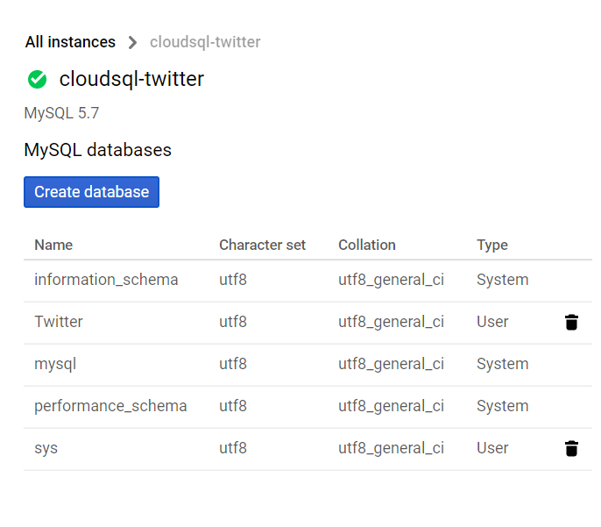
Data Pipeline
Why did we choose GCP ?
Storage is fast with uncapped bandwidth with strongly consistent listings. BigQuery, BigTable and lots of other services have "no-ops" so there's no overhead other than getting your work done. Support is also flat rate and not a rip-off percentage.
With numerous data breaches and security issues reported in the news almost daily, security is top of mind for many IT managers. Google Cloud Platform offers robust data privacy and security features.
Fully compatible with Jupyter Notebook, MySQL, and Tableau with convenient data transfer mechanism.

Slide 14
Data Pipeline
Visualization :
Plotting 20 most used hashtags, along with the number of times they appear in our dataset.

Slide 15
Data Pipeline
Visualization :
Plotting 20 most used hashtags, along with the number of times they appear in our dataset.

Slide 16
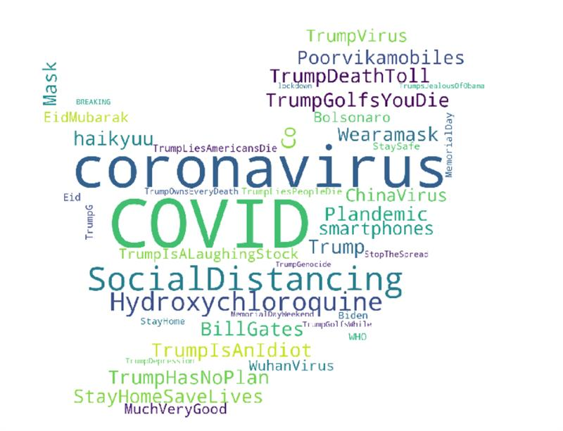
Data Pipeline
Visualization : Most Frequent Hashtags World Cloud

Slide 17
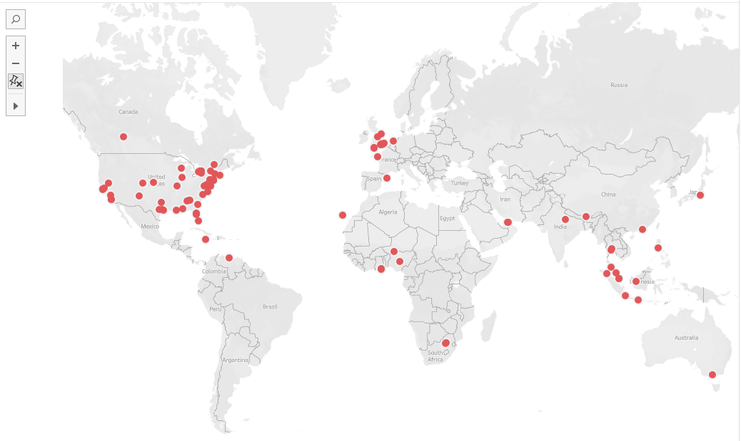
Data Pipeline
Visualization :
Identify the geographic locations of all the tweets gathered in our dataset.

Slide 18
Data Pipeline
Visualization :
Top 20 most mentioned accounts in the tweets.
These accounts are the most targeted one’s are may be directly/indirectly responsible for the flow of misinformation.

Slide 19
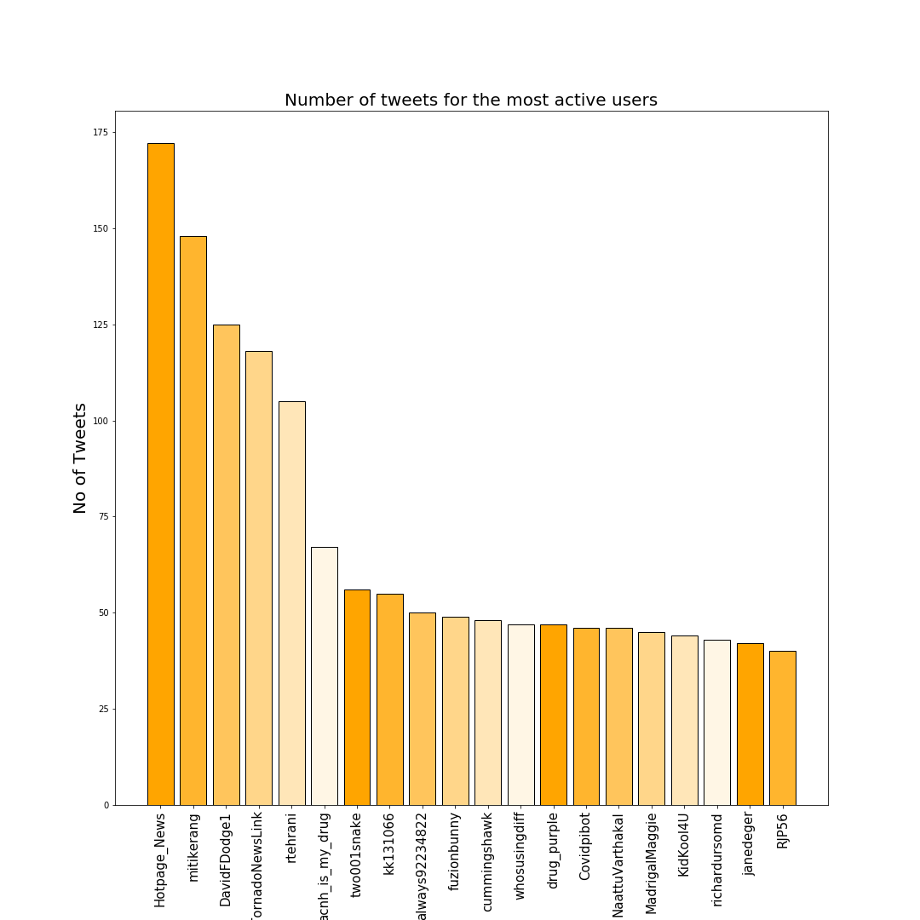
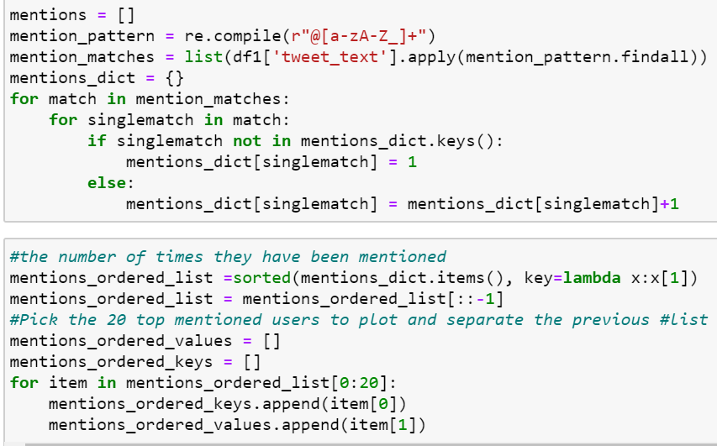
Data Pipeline
Visualization :
Top 20 usernames, who are tweeting the most.
Our investigation starts here!!!

Slide 20
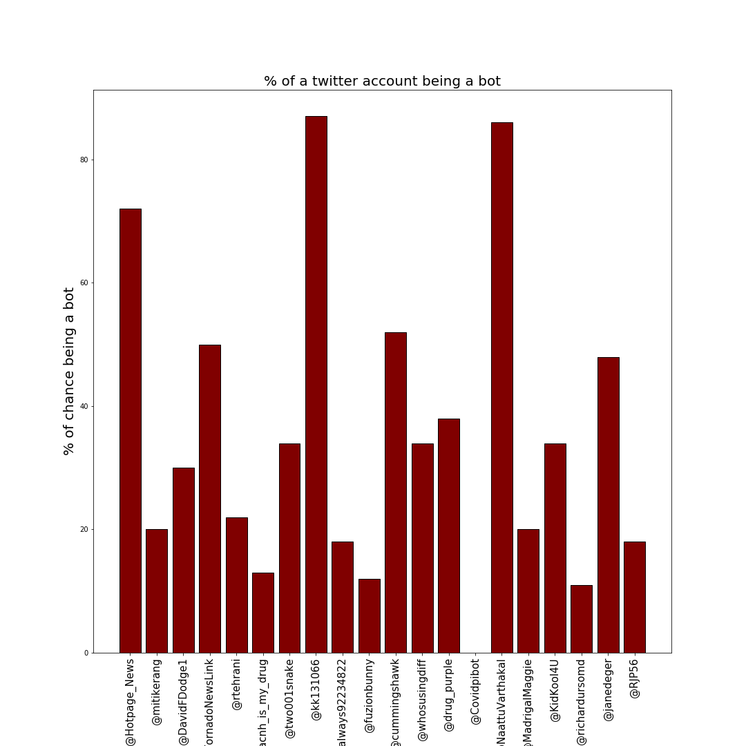
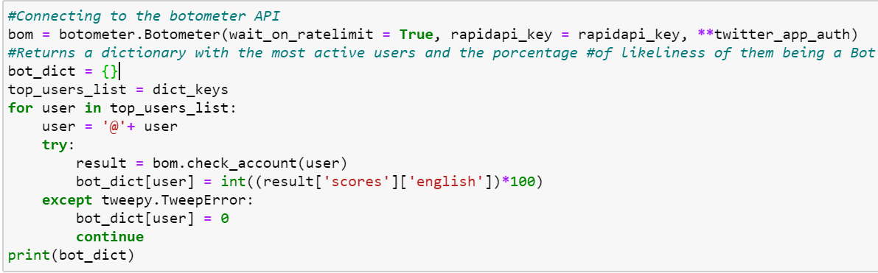
Data Pipeline
Visualization :
Predict the chances of these 20 usernames being a bot!!!

Slide 21
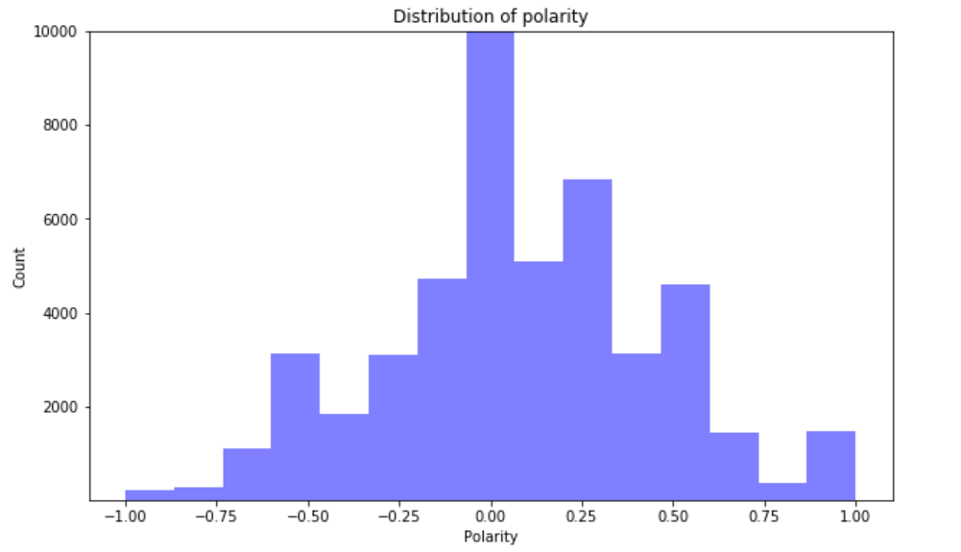
Data Pipeline
Visualization :
Polarity distribution using histogram
-1 stands for the extreme negative polarity
0 stands for the neutral polarity
+1 stands for the extreme positive polarity

Slide 22
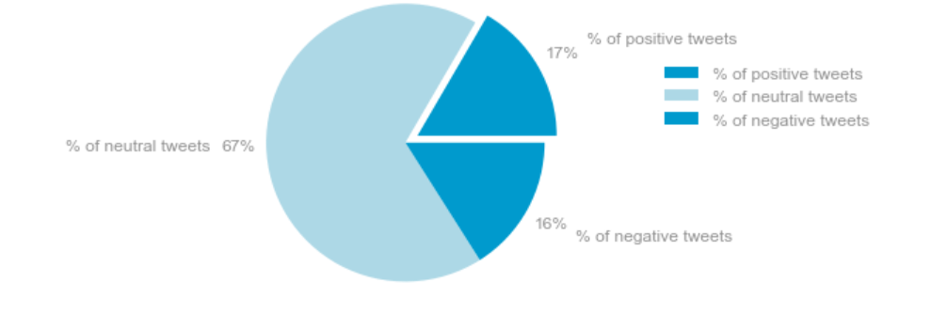
Data Pipeline
Visualization :
Sentiment % by hashtag & Category

Slide 23
Data Pipeline
Visualization :
Guess who has posted the most negative tweets???

Slide 24
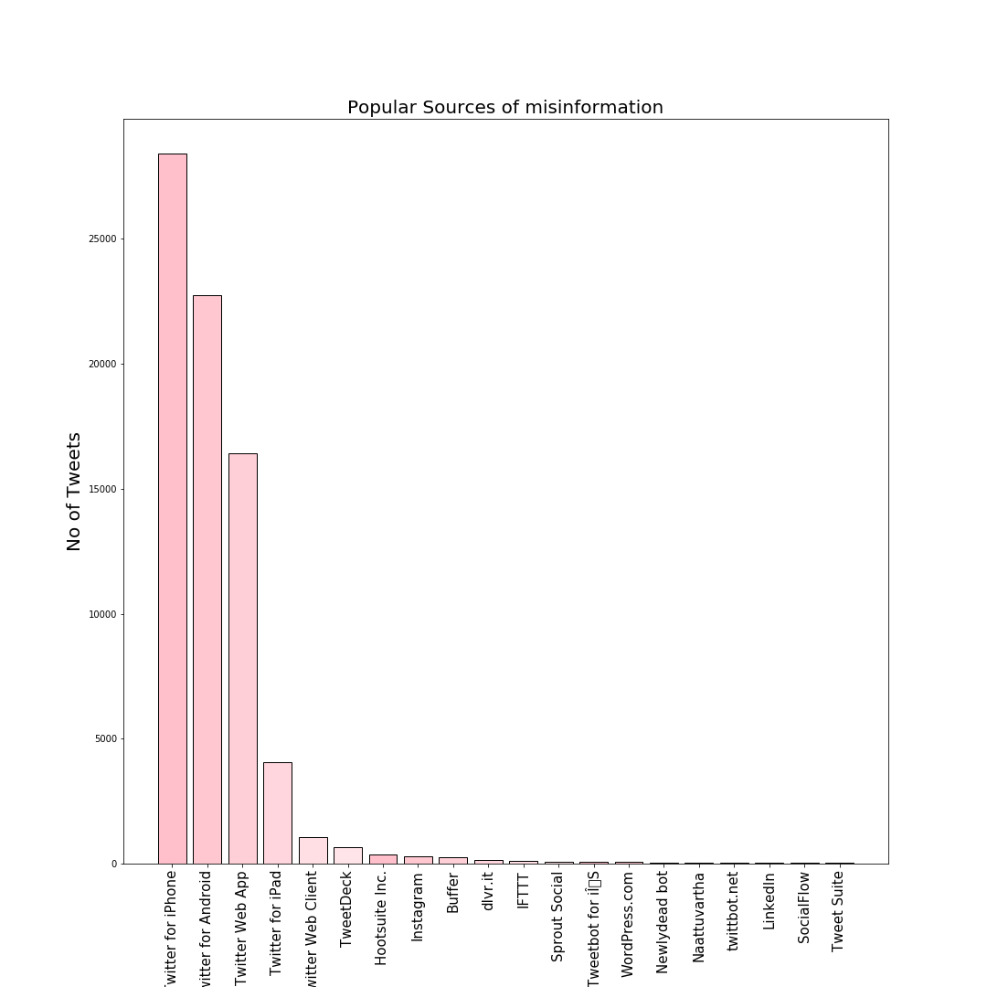
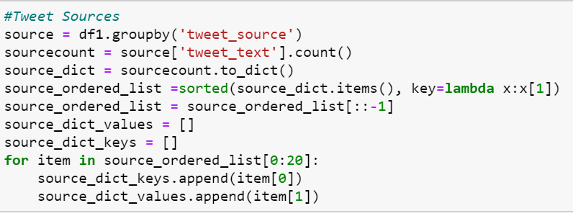
Data Pipeline
Visualization :
Identifying the root sources of misinformation!!

Slide 25
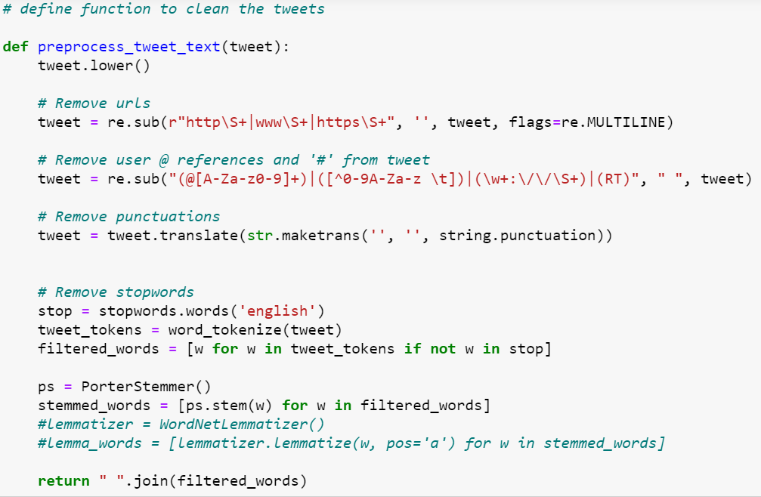
Data Pipeline
NLP & ML : Tweet Pre-Processing using NLTK & re
With the help of supervised ML, we are labeling the misleading and harmful tweets as Negative and this proves to be a strong base for our ultimate agenda to eradicate harmful tweet contents.
Note: Any suitable labels can be used.
To achieve this, we have implemented a pre-processing module utilizing NLTK & re to perform operations like tokenization, stemming, and lemmatization on our training & test dataset.

Slide 26
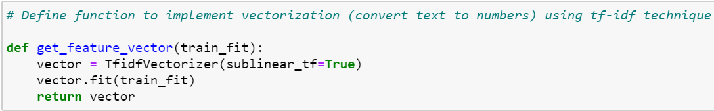
Data Pipeline
NLP & ML : Convert Text to numbers using TF-IDF technique
We have chosen TF-IDF technique to convert text to vectors

Slide 27
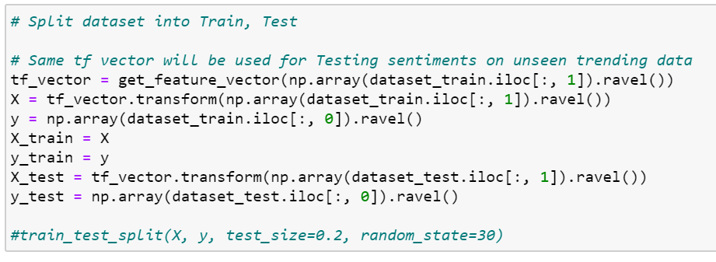
Data Pipeline
NLP & ML : Splitting data into train and test
We have specifically utilized the popular text classification algorithms like Logistic regression and Naïve Bayes classifier.
In this step we have split our main dataset to train and test datasets.

Slide 28
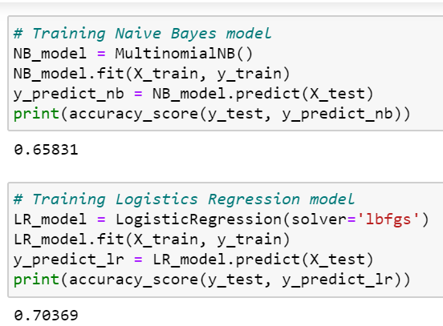
Data Pipeline
NLP & ML : Model fitting
Finally!! when we fit the model, we have achieved an accuracy of 70% for Logistic Regression model and 66% for the Naïve Bayes classifier.

Slide 29
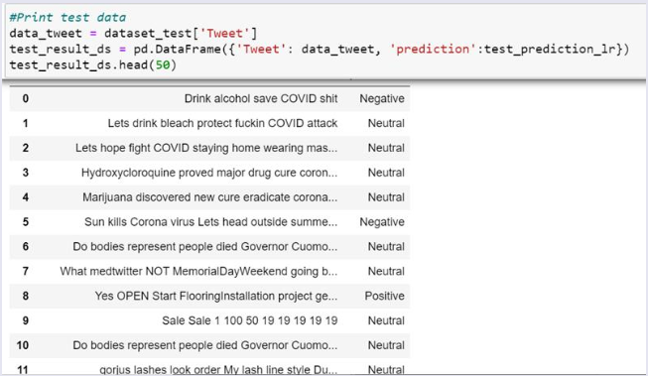
Data Pipeline
NLP & ML : Model Testing
Let’s test our model with the test data ;)

Slide 30
Data Pipeline
NLP & ML : Cross-Validation
Is our model classifying all misinformation tweets as negative ??
No, we have a long way to go in finetuning our model.
However, the good news is, it is predicting some wonderful insights and rightly classifies some harmful contents as negative, which is such a relief phewww :)

Slide 31
Conclusion
#Covid and #Trump were the most common hashtags in our dataset. These hashtags have a relatively neutral (~70%) sentiment, which aligns close with the average among all the hashtags
Most of the tweets related to Covid are posted from within the US and Europe, with scatterings in South East Asia and Africa
Close to 10% of the tweets related to Covid-19 mention @realRealDonaldTrump
The most hashtags with the most negative sentiment used were #covid19hoax and #emptyhospitals
We were able to create models that predicts the sentiments with accuracy of 70%
There is a strong positive correlation with the frequency of post and the percent chance that the user is a bot

Slide 32
Lessons Learned
What did we learn from this project ???
Getting access to twitter data is such a pain. It might take days or months or even years (No exaggerations here). It solely depends upon your application essay, where a developer has to specify his intention towards using the data.
Gone are those days, when the access to the twitter developer account was super instant. Make sure to be as honest as possible when applying for the developer access, as Twitter has recently started restricting the developer access. It took 2 weeks for us to get the access.
The standard REST API of the twitter is quite buggy and behaves weirdly sometimes. The search rate is limited, and one can only fetch the data from the past 7 seven days from the current date. Need more options? One has to pay for his access then, which is definitely not student friendly.
Make sure to read and read the rules to extract the tweets using the REST API. If the page size exceeds the limit, the user IP will be banned, and the access will be revoked permanently.

Slide 33
Lessons Learned
What did we learn from this project ???
Cleaning twitter data is extremely tricky. If we clean the major data chunk using the pre-processor algorithm, we will loose the major insights that we want to find. Hence, partial cleaning is recommended in the beginning.
Coding can sometimes get into your nerve, if you do not officially have an experience coding in Python. But hey, hard work pays off and we did learn a lot about NLP and ML techniques.
Uploading the data to MySQL can take so much of your time. Most of our data rows got skipped due to the tweet text attribute as it contains so many special characters. Thus, think wisely before choosing the right database.
Also, twitter data can get redundant if you plan to save the data batchwise. Hence, its recommended to save data in one shot or 2 max to max.
Choosing the right ML algorithm is always a challenge. So, do your homework wisely and start the ML and NLP part simultaneously with data cleaning and analysis, as it takes a lot of time to make stuff work.

Slide 34
Future Scope
What future plans do we have to finetune our existing model???
Improve the prediction accuracy and train model on the varied datasets to handle multiple test cases.
Build the application to remove misleading tweets real-time.
Build a cross-platform application, that can be used across other social media platforms like Facebook, Instagram, LinkedIn etc.

